Slide 1
Graph Searching Techniques Topological Sorting
Prepared by
Lec Shekh. Md. Saifur Rahman
PREPARED BY
SWAPNIL BISWAS

Slide 2
Graph Searching
Given: a graph G = (V, E), directed or undirected
Goal: methodically explore every vertex and every edge.
Ultimately: build a tree on the graph
Pick a vertex as the root
Choose certain edges to produce a tree
Note: might also build a forest if graph is not connected
There are two standard graph traversal techniques:
Breadth-First Search (BFS)
Depth-First Search (DFS)
Special thanks to Professor Abul Kashem sir for the invaluable resources

Slide 3
Level of a Graph
What is level?
5
Source vertex is from Level-0
Level-0
5
Level-i+1 contains all the undiscovered adjacent vertices of Level-i
1
4
6
Level-1
1
4
6
Level is considered as the minimum distance from the source
7
2
0
3
Level-2
7
2
0
3
Level-1 vertices:
1 4 6
Level-0 vertices:
5
Undiscovered Adjacent vertices of {1,4,6}:
7 2 0 3
Undiscovered Adjacent vertices of 5:
1
4
6
So, Level-2 vertices are:
7 2 0 3
So, Level-1 vertices are:
1
4
6
Special thanks to Swapnil Biswas sir for the invaluable resources

Slide 4
Level of a Graph
Find the total number of levels in the graph and list down the vertices of all level considering 5 as source
Level-0 :
{5}
Level-1 :
{1, 2, 4, 6}
5
5
Level-2 :
{0, 3, 7, 8}
1
4
6
So, here number of level=3
1
4
6
In short: Level of a vertex denotes its shortest distance from the source
7
2
0
3
7
2
0
3
Levels of a graph is not fixed. It depends on the source
Here, consider vertex-0 as source and then identify different levels
8
8
Level-0 :
{0}
Level-3 :
{1,2,4}
Level-1 :
{6}
Level-4 :
{7,8}
Level-2 :
{3,5}
Special thanks to Swapnil Biswas sir for the invaluable resources

Slide 5
Breadth-First Search (BFS)
BFS involves visiting all the connected nodes of a graph in a level-by-level manner.
Builds a tree over the graph – BFS Spanning tree
Pick a source vertex to be the root
Find (“discover”) its children, then their children, etc.
Applications:
BFS is commonly used in algorithms for pathfinding, connected components, and shortest path problems in graphs.
Special thanks to Professor Abul Kashem sir for the invaluable resources

Slide 6
Breadth-First Search (BFS)
We divide the vertices into two categories:
Visited and
Not visited.
Initially all vertices will be not visited.
BFS uses a queue data structure for traversal.
Special thanks to Professor Abul Kashem sir for the invaluable resources

Slide 7
BFS - Algorithm
Let’s discuss the algorithm for the BFS:
Initialization: Enqueue the source node into the queue and mark it as visited.
Exploration: While the queue is not empty:
Dequeue a node from the queue
For each unvisited neighbor of the dequeued node:
Enqueue the neighbor into the queue.
Mark the neighbor as visited.
Termination: Repeat step 2 until the queue is empty.
This algorithm ensures that all nodes in the graph are visited in a breadth-first manner, starting from a source vertex
Special thanks to Professor Abul Kashem sir for the invaluable resources

Slide 8
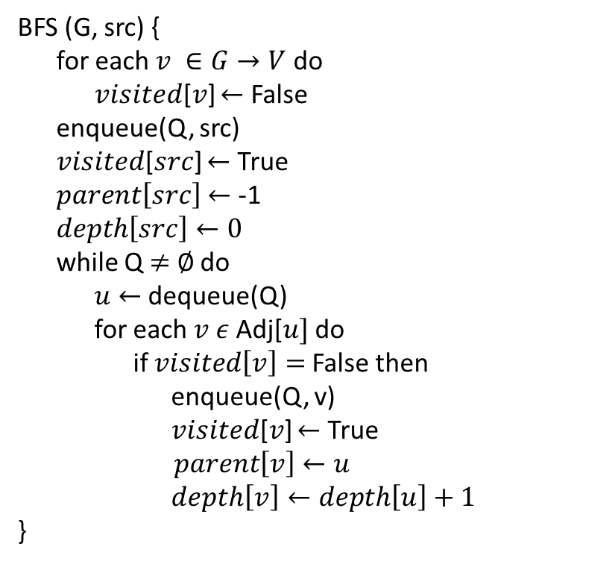
BFS - Algorithm
Initialization: Enqueue the source node into the queue and mark it as visited.
Exploration: While the queue is not empty:
Dequeue a node from the queue
For each unvisited neighbor of the dequeued node:
Enqueue the neighbor into the queue.
Mark the neighbor as visited.
Termination: Repeat step 2 until the queue is empty.
BFS (G, src) {
for each $v ∈G→V$do
𝑣𝑖𝑠𝑖𝑡𝑒𝑑[𝑣] $←$ False
enqueue(Q, src)
𝑣𝑖𝑠𝑖𝑡𝑒𝑑[$src$] $←$ True
$parent\left[src\right]$ $←$ -1
$depth\left[src\right]←0$
while Q $≠$ $∅$ do
$u$ $←$ dequeue(Q)
for each $v ε$Adj[$u]$ do
if $visited\left[v\right]=$False then
enqueue(Q, v)
𝑣𝑖𝑠𝑖𝑡𝑒𝑑[𝑣] $←$ True
$parent\left[v\right]$ $←u$
$depth\left[v\right]←depth\left[u\right]+1$
}
Special thanks to Professor Abul Kashem sir for the invaluable resources

Slide 9
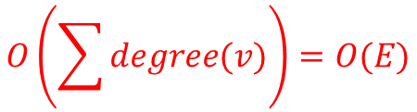

BFS – Algorithm (Time Complexity)
BFS (G, src) {
for each $v ∈G→V$do
𝑣𝑖𝑠𝑖𝑡𝑒𝑑[𝑣] $←$ False
enqueue(Q, src)
𝑣𝑖𝑠𝑖𝑡𝑒𝑑[src] $←$ True
$parent\left[src\right]$ $←$ -1
$depth\left[src\right]←0$
while Q $≠$ $∅$ do
$u$ $←$ dequeue(Q)
for each $v ε$Adj[$u]$ do
if $visited\left[v\right]=$False then
𝑣𝑖𝑠𝑖𝑡𝑒𝑑[𝑣] $←$ True
enqueue(Q, v)
$parent\left[v\right]$ $←u$
$depth\left[v\right]←depth\left[u\right]+1$
}
Touch every vertex: O(V)
Every vertex, but only once. (Why?)
$$O\left(\sum{degree(v)}\right)=O(E)$$
Total running time:
O(V + E)
Special thanks to Professor Abul Kashem sir for the invaluable resources

Slide 10
BFS – Algorithm (Auxiliary Space Complexity)
BFS (G, src) {
for each $v ∈G→V$do
𝑣𝑖𝑠𝑖𝑡𝑒𝑑[𝑣] $←$ False
enqueue(Q, src)
𝑣𝑖𝑠𝑖𝑡𝑒𝑑[src] $←$ True
$parent\left[src\right]$ $←$ -1
$depth\left[src\right]←0$
while Q $≠$ $∅$ do
$u$ $←$ dequeue(Q)
for each $v ε$Adj[$u]$ do
if $visited\left[v\right]=$False then
𝑣𝑖𝑠𝑖𝑡𝑒𝑑[𝑣] $←$ True
enqueue(Q, v)
$parent\left[v\right]$ $←u$
$depth\left[v\right]←depth\left[u\right]+1$
}
Store every vertex: O(V)
Store every vertex, but only once. (Why?)
Total required auxiliary space:
O(V)
Special thanks to Professor Abul Kashem sir for the invaluable resources

Slide 11
How Does the BFS Algorithm Work?
Step1: Initially queue is empty and all nodes are unvisited (here, 0 means unvisited and 1 means visited).
0 | 1 | 2 | 3 | 4
1
3
Visited
0 | 0 | 0 | 0 | 0
0
Queue
2
4
FRONT
Special thanks to Professor Abul Kashem sir for the invaluable resources

Slide 12
How Does the BFS Algorithm Work?
Step 2: Push node 0 into queue and mark it visited.
0 | 1 | 2 | 3 | 4
1
3
Visited
1 | 0 | 0 | 0 | 0
0
Queue
0
2
4
FRONT
Special thanks to Professor Abul Kashem sir for the invaluable resources

Slide 13
How Does the BFS Algorithm Work?
Step 3: Remove node 0 from the front of queue and visit the unvisited neighbours and push them into queue.
0 | 1 | 2 | 3 | 4
1
3
Visited
1 | 1 | 1 | 0 | 0
0
Queue
1 | 2
2
4
FRONT
Special thanks to Professor Abul Kashem sir for the invaluable resources

Slide 14
How Does the BFS Algorithm Work?
Step 4: Remove node 1 from the front of queue and visit the unvisited neighbours and push them into queue.
0 | 1 | 2 | 3 | 4
1
3
Visited
1 | 1 | 1 | 1 | 0
0
Queue
2 | 3
2
4
FRONT
Special thanks to Professor Abul Kashem sir for the invaluable resources

Slide 15
How Does the BFS Algorithm Work?
Step 5: Remove node 2 from the front of queue and visit the unvisited neighbours and push them into queue.
0 | 1 | 2 | 3 | 4
1
3
Visited
1 | 1 | 1 | 1 | 1
0
Queue
3 | 4
2
4
FRONT
Special thanks to Professor Abul Kashem sir for the invaluable resources

Slide 16
How Does the BFS Algorithm Work?
Step 6: Remove node 3 from the front of queue and visit the unvisited neighbours and push them into queue.
0 | 1 | 2 | 3 | 4
1
3
Visited
1 | 1 | 1 | 1 | 1
0
Queue
4
2
4
FRONT
Special thanks to Professor Abul Kashem sir for the invaluable resources

Slide 17
How Does the BFS Algorithm Work?
Step 7: Remove node 4 from the front of queue and visit the unvisited neighbours and push them into queue.
0 | 1 | 2 | 3 | 4
1
3
Visited
1 | 1 | 1 | 1 | 1
0
Queue
2
4
FRONT
Now, Queue becomes empty, So, terminate these process of iteration.
Special thanks to Professor Abul Kashem sir for the invaluable resources

Slide 18
How Does the BFS Algorithm Work?
Output:
1
3
0
2
4
BFS Spanning Tree
Special thanks to Professor Abul Kashem sir for the invaluable resources

Slide 19
BFS – disconnected Graph
?
Special thanks to Professor Abul Kashem sir for the invaluable resources

Slide 20
BFS – Properties
BFS calculated the shortest-path distance to the source node.
BFS builds breadth-first spanning tree (forest), in which paths to root(s) represent shortest paths in G
Thus can use BFS to calculate shortest path from one vertex to another in O(V + E) time in an unweighted graph.
Special thanks to Professor Abul Kashem sir for the invaluable resources

Slide 21
Depth-First Search
Depth-first search is another strategy for exploring a graph
Depth first Search or Depth first traversal is a recursive algorithm for searching all the vertices of a graph.
We divide the vertices into two categories:
Visited and
Not visited.
Initially all vertices will be not visited.
DFS employs a backtracking technique for traversing graphs and trees.
Special thanks to Professor Abul Kashem sir for the invaluable resources

Slide 22
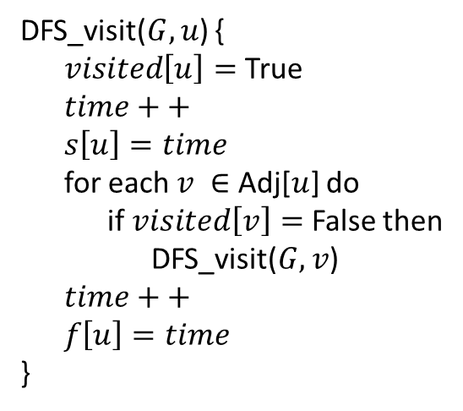
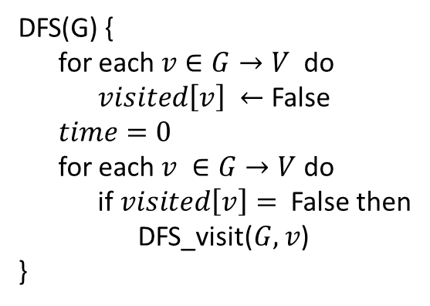
DFS - Algorithm
DFS(G) {
for each $v∈G→V$do
$visited\left[v\right] ←$ False
$time=0$
for each $v ∈G→V$ do
if $visited\left[v\right]=$ False then
DFS_visit($G, v$)
}
DFS_visit($G, u$) {
$visited\left[u\right]=$True
$time++$
$s\left[u\right]=time$
for each $v ∈$ Adj[$u$] do
if $visited\left[v\right]=$ False then
DFS_visit($G, v$)
$time++$
$f\left[u\right]=time$
}
Special thanks to Professor Abul Kashem sir for the invaluable resources

Slide 23
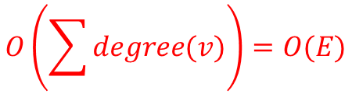
DFS – Algorithm (Time complexity analysis)
DFS(G) {
for each $v∈G→V$do
$visited\left[v\right] ←$ False
$time=0$
for each $v ∈G→V$ do
if $visited\left[v\right]=$ False then
DFS_visit($G, v$)
}
DFS_visit($G, u$) {
$visited\left[u\right]=$True
$time++$
$s\left[u\right]=time$
for each $v ∈$ Adj[$u$] do
if $visited\left[v\right]=$ False then
DFS_visit($G, v$)
$time++$
$f\left[u\right]=time$
}
$$O\left(\sum{degree(v)}\right)=O(E)$$
Touch every vertex: O(V)
Special thanks to Professor Abul Kashem sir for the invaluable resources

Slide 24



DFS – Algorithm (Time complexity analysis)
DFS(G) {
for each $v∈G→V$do
$visited\left[v\right] ←$ False
$time=0$
for each $v ∈G→V$ do
if $visited\left[v\right]=$ False then
DFS_visit($G, v$)
}
DFS_visit($G, u$) {
$visited\left[u\right]=$True
$time++$
$s\left[u\right]=time$
for each $v ∈$ Adj[$u$] do
if $visited\left[v\right]=$ False then
DFS_visit($G, v$)
$time++$
$f\left[u\right]=time$
}
$$O(E)$$
Touch every vertex: O(V)
$$O(E)$$
Running time: O(V*E$)$
Special thanks to Professor Abul Kashem sir for the invaluable resources

Slide 25
DFS – Algorithm (Time complexity analysis)
DFS(G) {
for each $v∈G→V$do
$visited\left[v\right] ←$ False
$time=0$
for each $v ∈G→V$ do
if $visited\left[v\right]=$ False then
DFS_visit($G, v$)
}
DFS_visit($G, u$) {
$visited\left[u\right]=$True
$time++$
$s\left[u\right]=time$
for each $v ∈$ Adj[$u$] do
if $visited\left[v\right]=$ False then
DFS_visit($G, v$)
$time++$
$f\left[u\right]=time$
}
$$O(E)$$
Touch every vertex: O(V)
$$O(E)$$
But, there is actually a tighter bound. How many times will DFS_visit() actually be called?
Special thanks to Professor Abul Kashem sir for the invaluable resources

Slide 26
DFS – Algorithm (Time complexity analysis)
DFS(G) {
for each $v∈G→V$do
$visited\left[v\right] ←$ False
$time=0$
for each $v ∈G→V$ do
if $visited\left[v\right]=$ False then
DFS_visit($G, v$)
}
DFS_visit($G, u$) {
$visited\left[u\right]=$True
$time++$
$s\left[u\right]=time$
for each $v ∈$ Adj[$u$] do
if $visited\left[v\right]=$ False then
DFS_visit($G, v$)
$time++$
$f\left[u\right]=time$
}
$$O(E)$$
Touch every vertex: O(V)
$$O(E)$$
So, running time of DFS = O(V+E)
Special thanks to Professor Abul Kashem sir for the invaluable resources

Slide 27
DFS – Algorithm (Space complexity analysis)
DFS(G) {
for each $v∈G→V$do
$visited\left[v\right] ←$ False
$time=0$
for each $v ∈G→V$ do
if $visited\left[v\right]=$ False then
DFS_visit($G, v$)
}
DFS_visit($G, u$) {
$visited\left[u\right]=$True
$time++$
$s\left[u\right]=time$
for each $v ∈$ Adj[$u$] do
if $visited\left[v\right]=$ False then
DFS_visit($G, v$)
$time++$
$f\left[u\right]=time$
}
Total required Auxiliary Space = O(V)
Special thanks to Professor Abul Kashem sir for the invaluable resources

Slide 28
How Does the DFS Algorithm Work?
Source
vertex
Special thanks to Professor Abul Kashem sir for the invaluable resources

Slide 29
How Does the DFS Algorithm Work?
Source
vertex
s
f
1
Special thanks to Professor Abul Kashem sir for the invaluable resources

Slide 30
How Does the DFS Algorithm Work?
Source
vertex
s
f
1
2
Special thanks to Professor Abul Kashem sir for the invaluable resources

Slide 31
How Does the DFS Algorithm Work?
Source
vertex
s
f
1
2
3
Special thanks to Professor Abul Kashem sir for the invaluable resources

Slide 32
How Does the DFS Algorithm Work?
Source
vertex
s
f
1
2
3
4
Special thanks to Professor Abul Kashem sir for the invaluable resources

Slide 33
How Does the DFS Algorithm Work?
Source
vertex
s
f
1
2
3
4
5
Special thanks to Professor Abul Kashem sir for the invaluable resources

Slide 34
How Does the DFS Algorithm Work?
Source
vertex
s
f
1
2
3
4
5
6
Special thanks to Professor Abul Kashem sir for the invaluable resources

Slide 35
How Does the DFS Algorithm Work?
Source
vertex
s
f
1
2
7
3
4
5
6
Special thanks to Professor Abul Kashem sir for the invaluable resources

Slide 36
How Does the DFS Algorithm Work?
Source
vertex
s
f
1
8
2
7
3
4
5
6
Special thanks to Professor Abul Kashem sir for the invaluable resources

Slide 37
How Does the DFS Algorithm Work?
Source
vertex
s
f
1
8
2
7
9
3
4
5
6
Special thanks to Professor Abul Kashem sir for the invaluable resources

Slide 38
How Does the DFS Algorithm Work?
Source
vertex
s
f
1
8
2
7
9
10
3
4
5
6
Special thanks to Professor Abul Kashem sir for the invaluable resources

Slide 39
How Does the DFS Algorithm Work?
Source
vertex
s
f
1
8
11
2
7
9
10
3
4
5
6
Special thanks to Professor Abul Kashem sir for the invaluable resources

Slide 40
How Does the DFS Algorithm Work?
Source
vertex
s
f
1
12
8
11
2
7
9
10
3
4
5
6
Special thanks to Professor Abul Kashem sir for the invaluable resources

Slide 41
How Does the DFS Algorithm Work?
Source
vertex
s
f
1
12
8
11
13
2
7
9
10
3
4
5
6
Special thanks to Professor Abul Kashem sir for the invaluable resources

Slide 42
How Does the DFS Algorithm Work?
Source
vertex
s
f
1
12
8
11
13
2
7
9
10
3
4
5
6
14
Special thanks to Professor Abul Kashem sir for the invaluable resources

Slide 43
How Does the DFS Algorithm Work?
Source
vertex
s
f
1
12
8
11
13
2
7
9
10
3
4
5
6
14
15
Special thanks to Professor Abul Kashem sir for the invaluable resources

Slide 44
How Does the DFS Algorithm Work?
Source
vertex
s
f
1
12
8
11
13
16
2
7
9
10
3
4
5
6
14
15
Special thanks to Professor Abul Kashem sir for the invaluable resources

Slide 45
How Does the DFS Algorithm Work?
DFS introduces an important distinction among edges in the original graph:
Source
vertex
s
f
1
12
8
11
13
16
2
7
9
10
3
4
5
6
14
15
Special thanks to Professor Abul Kashem sir for the invaluable resources

Slide 46
How Does the DFS Algorithm Work?
DFS introduces an important distinction among edges in the original graph:
Source
vertex
s
f
1
12
8
11
13
16
2
7
9
10
3
4
5
6
14
15
Tree Edge
Special thanks to Professor Abul Kashem sir for the invaluable resources

Slide 47
How Does the DFS Algorithm Work?
DFS introduces an important distinction among edges in the original graph:
Source
vertex
s
f
1
12
8
11
13
16
2
7
9
10
3
4
5
6
14
15
Back Edge: from descendent to ancestor
Special thanks to Professor Abul Kashem sir for the invaluable resources

Slide 48
How Does the DFS Algorithm Work?
DFS introduces an important distinction among edges in the original graph:
Source
vertex
s
f
1
12
8
11
13
16
2
7
9
10
3
4
5
6
14
15
Forward Edge: from ancestor to descendent (not a tree edge though)
Special thanks to Professor Abul Kashem sir for the invaluable resources

Slide 49
How Does the DFS Algorithm Work?
DFS introduces an important distinction among edges in the original graph:
Source
vertex
s
f
1
12
8
11
13
16
2
7
9
10
3
4
5
6
14
15
Cross Edge: between trees or between subtrees
Special thanks to Professor Abul Kashem sir for the invaluable resources

Slide 50
How Does the DFS Algorithm Work?
DFS introduces an important distinction among edges in the original graph:
Source
vertex
s
f
1
12
8
11
13
16
2
7
9
10
3
4
5
6
14
15
Tree Edges Back edges Forward edges Cross edges
Note: tree and back edges are very important; some algorithms use forward and cross edges
Special thanks to Professor Abul Kashem sir for the invaluable resources

Slide 51
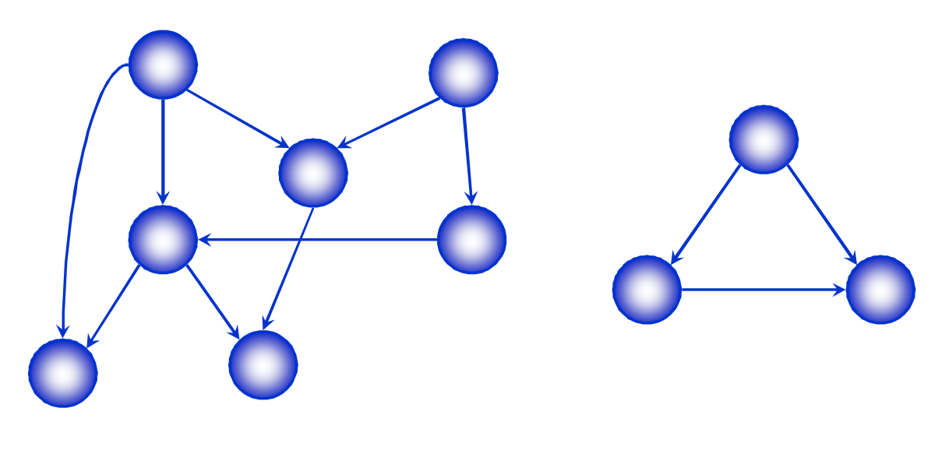
Directed Acyclic Graphs
A directed acyclic graph or DAG is a directed graph with no directed cycles
Special thanks to Professor Abul Kashem sir for the invaluable resources

Slide 52
Topological Sort
A topological sort of a DAG is
A linear ordering of all vertices of the graph G such that vertex u comes before vertex v if (u, v) is an edge in G.
DAG indicates precedence among events:
Events are graph vertices, edge from u to v means event u has precedence over even v.
Real-world example:
Course registration
Tasks for eating meal
Special thanks to Professor Abul Kashem sir for the invaluable resources

Slide 53
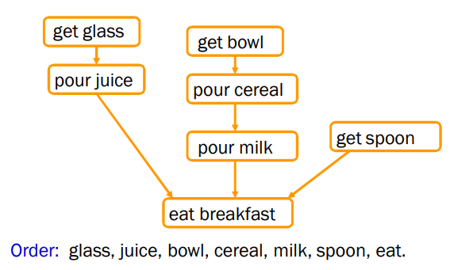
Precedence Example
Tasks that have to be done to eat breakfast:
Get glass, pour juice, get bowl, pour cereal, pour milk, get spoon, eat.
Certain evens must happen in a certain order (ex: get bowl before pouring milk)
For other evens, it doesn’t matter (ex: get bowl and get spoon)
Special thanks to Professor Abul Kashem sir for the invaluable resources

Slide 54
Why Acyclic?
Why must directed graph by acyclic for the topological sort problem?
Otherwise, no way to order events linearly without violating a precedence constraint.
Special thanks to Professor Abul Kashem sir for the invaluable resources

Slide 55
Topological Sort: Using In-degree
Steps for finding the topological ordering of DAG:
Step-1: Compute in-degree for each of the vertices present in the DAG and initialize the count of visited nodes as 0;
Step-2: Add all vertices with in-degree equal 0 into a queue
Step-3: Remove a vertex from the queue and then
Increment count of visited nodes by 1;
Decrease in-degree by 1 for all its neighboring nodes;
If in-degree of a neighboring node is reduced to zero, then add it to the queue;
Step-4: Repeat Step-3 until the queue is empty;
Step 5: If count of visited nodes is not equal to the number of nodes in the graph then the topological sort is not possible for the given graph.
Special thanks to Professor Abul Kashem sir for the invaluable resources

Slide 56
Topological Sort: Using In-degree
0
1
2
4
5
3
Special thanks to Professor Abul Kashem sir for the invaluable resources

Slide 57
Topological Sort: Using In-degree
0
1
2
4
5
3
Queue: 0
In degree
0 | 1 | 1 | 3 | 2 | 3
0 | 1 | 2 | 3 | 4 | 5
Sequence:
Special thanks to Professor Abul Kashem sir for the invaluable resources

Slide 58
Topological Sort: Using In-degree
1
2
4
5
3
Queue: 1
In degree
0 | 0 | 1 | 2 | 2 | 3
0 | 1 | 2 | 3 | 4 | 5
Sequence: 0
Special thanks to Professor Abul Kashem sir for the invaluable resources

Slide 59
Topological Sort: Using In-degree
2
4
5
3
Queue: 2
In degree
0 | 0 | 0 | 1 | 2 | 3
0 | 1 | 2 | 3 | 4 | 5
Sequence: 0 1
Special thanks to Professor Abul Kashem sir for the invaluable resources

Slide 60
Topological Sort: Using In-degree
4
5
3
Queue: 3
In degree
0 | 0 | 0 | 0 | 1 | 2
0 | 1 | 2 | 3 | 4 | 5
Sequence: 0 1 2
Special thanks to Professor Abul Kashem sir for the invaluable resources

Slide 61
Topological Sort: Using In-degree
4
5
Queue: 4
In degree
0 | 0 | 0 | 0 | 0 | 1
0 | 1 | 2 | 3 | 4 | 5
Sequence: 0 1 2 3
Special thanks to Professor Abul Kashem sir for the invaluable resources

Slide 62
Topological Sort: Using In-degree
5
Queue: 5
In degree
0 | 0 | 0 | 0 | 0 | 0
0 | 1 | 2 | 3 | 4 | 5
Sequence: 0 1 2 3 4
Special thanks to Professor Abul Kashem sir for the invaluable resources

Slide 63
Topological Sort: Using In-degree
Queue:
In degree
0 | 0 | 0 | 0 | 0 | 0
0 | 1 | 2 | 3 | 4 | 5
Sequence: 0 1 2 3 4 5
Special thanks to Professor Abul Kashem sir for the invaluable resources

Slide 64
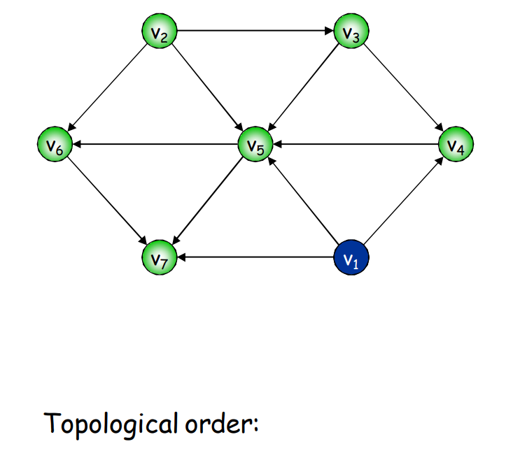
Topological Sort: Using In-degree
??
Special thanks to Professor Abul Kashem sir for the invaluable resources

Slide 65
Thank You
Questions

